Slide 1
The Correlation between Youth Tobacco Consumption and Mortality Rate
Group Pyramid
Bingyue Zeng, Jie Lu, Qilin Liu, Xin Sui

Slide 2
Introduction: Background & Why Important?
From 2017 to 2018, “Use of any tobacco product grew by 38.3% among high school students”. (See reference 7)
If cigarette smoking keeps high among youth, teenagers would be exposed to higher risks of dying early.(See reference 6)
The youth who use multiple tobacco products are at higher risk for developing nicotine dependence. (See reference 6)
Present Limitation:
According to Tobacco twenty-One website, only 31 of the 51 states are “Tobacco 21 state”. (See reference 8)
FDA's Youth Tobacco Prevention Plan mainly pays attention to e-cigarette instead of other tobacco.
Current policies pays more attention on alcohol instead of tobacco.

Slide 3
Problem Statement
Project aim:
To explore if there is a correlation between youth tobacco consumption and four types of mortality (cancer, heart disease, drug overdose and stroke).
Addressing the correlation will have:
practical benefits for preventing tobacco use among middle school and high school students (See reference 6).
contribute to understanding of the widespread smoking phenomenon among youth.

Slide 4
Hypothesis & Variables:
Smoking rate is positively correlated with mortality rate.
The mortality rates (cancer, heart disease, drug overdose, stroke) are correlated to each other.
Smoking rate is associated with different demographic segmentations such as gender, education and smoking type.
The total mortality rate varies in different smoke types (cessation, cigarette, smokeless tobacco).
Mortality rates of heart attack, cancer, overdose, and stroke have significant difference.
Independent variables: (tend to have some effects on the dependent variables)
Year, Longitude, Latitude, State, Smoke Type, Gender, Education, Smoke Rate
Dependent variables: (variables closely related to smoking behaviors)
Cancer Mortality Rate, Heart Disease Mortality Rate, Drug Overdose Mortality Rate, Strokes Mortality Rate, Death Rate over State

Slide 5
Dataset & Description
Period: 2014 - 2017; Variables: 12 variables; Rows: 10601 rows
Size = 4*12*10601 = 508848
Primary data link: chronicdata.cdc.gov/Survey-Data/Youth-Tobacco-Survey-YTS-Data/4juz-x2tp
Primary: (see reference 1)
The Youth Tobacco Survey (YTS) was developed to provide states with comprehensive data on students with different education level.
Secondary: (see reference 2, 3, 4, 5)
CDC provides a number of age-adjusted death rates, which are available in csv.
We cleaned the state abbreviation and merged the data using ‘State’ as the key.
We left joined the secondary datasets with the YTS dataset.
Tools selection:
Tableau: exploratory data analysis and visualization.
Python: dataset cleansing, statistical machine learning model building.

Slide 6
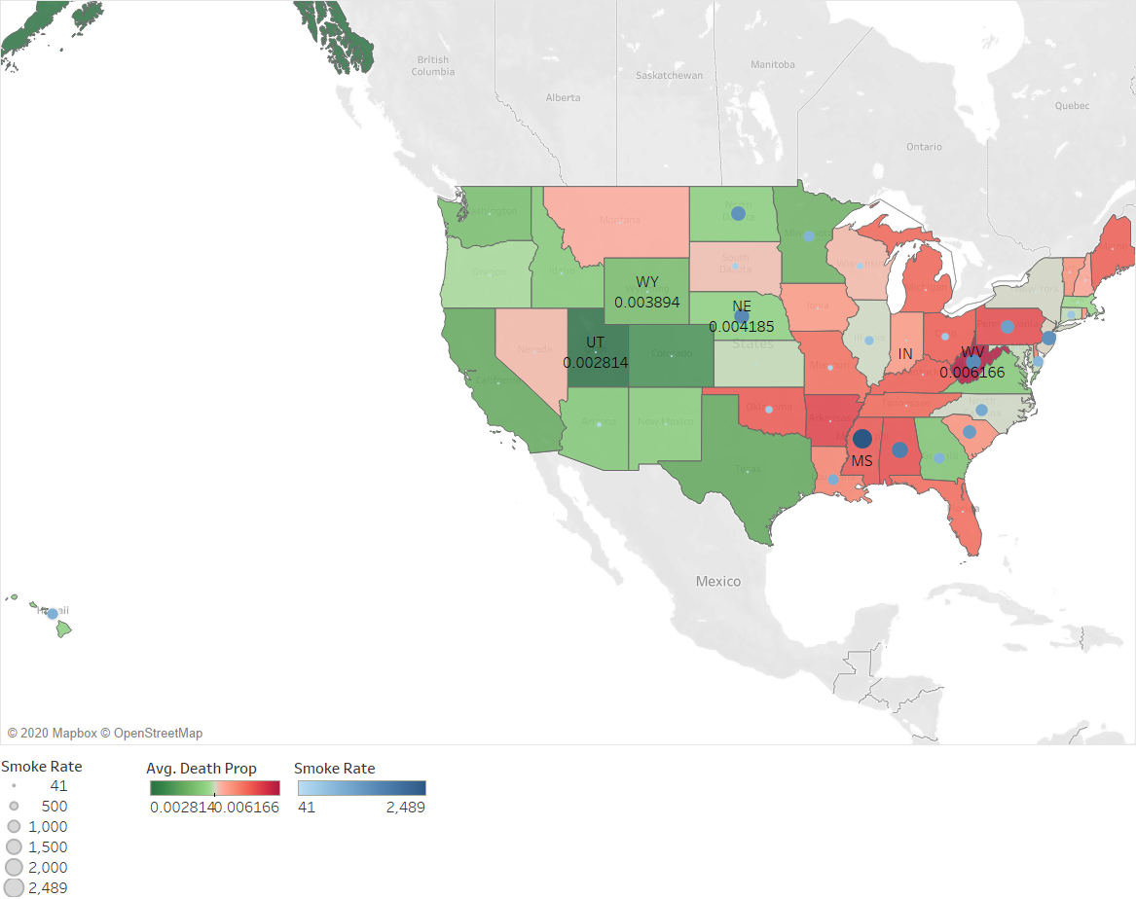
Figure 1. Average death rate/smoke rate distribution heat map - Qilin Liu
The state which has the highest smoking death rate is West Virginia (0.616%), and lowest is Utah (0.281%).
Higher smoking rate (larger blue dots) is associated with higher youth smoke-related death proportion (more redness).
The outliers like Nebraska: other reasons’ death rate death rate rose a lot like obesity/Excessive drinking, decreased proportion of youth smoking-related death rate.

Slide 7
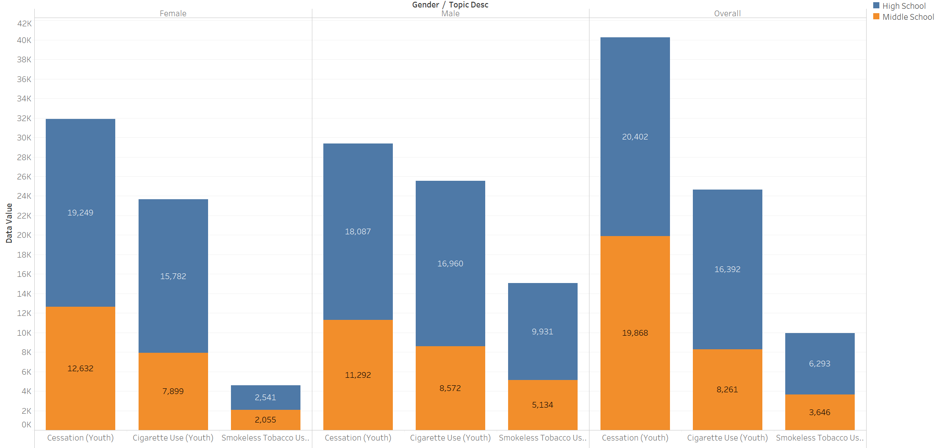
Figure 2. Frequency of youth smoking status - Jie Lu
Stacked bar chart showing the frequency of youth smoking status
Height --- frequency; facet --- gender; column --- smoking type; color --- education
It shows smoking rates among the segments: male more than female, high school students smokes slightly more than middle school students

Slide 8
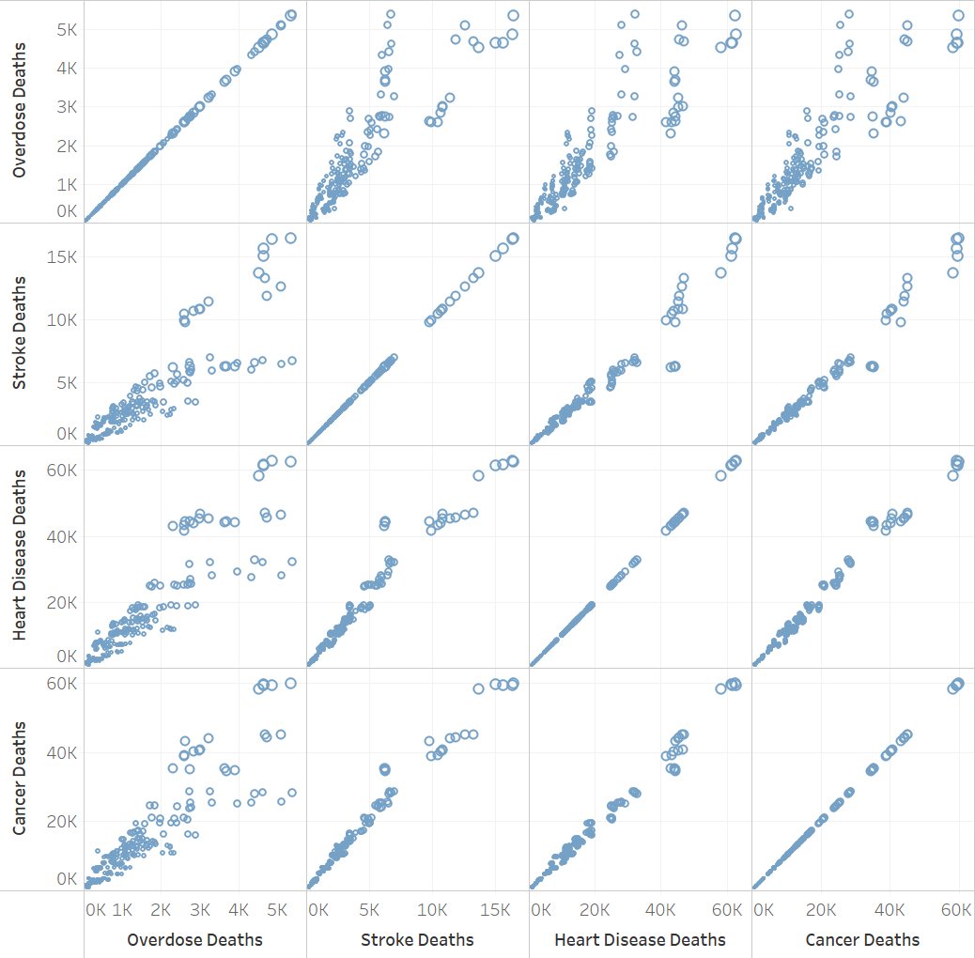
Figure 3. Correlation among mortality causes - Jie Lu
Scatterplot showing the correlation among various mortality causes.
The x-axis and y-axis include the same features, and each cell displays the relationship between two
Interestingly, those death causes are all positively correlated with each other.

Slide 9
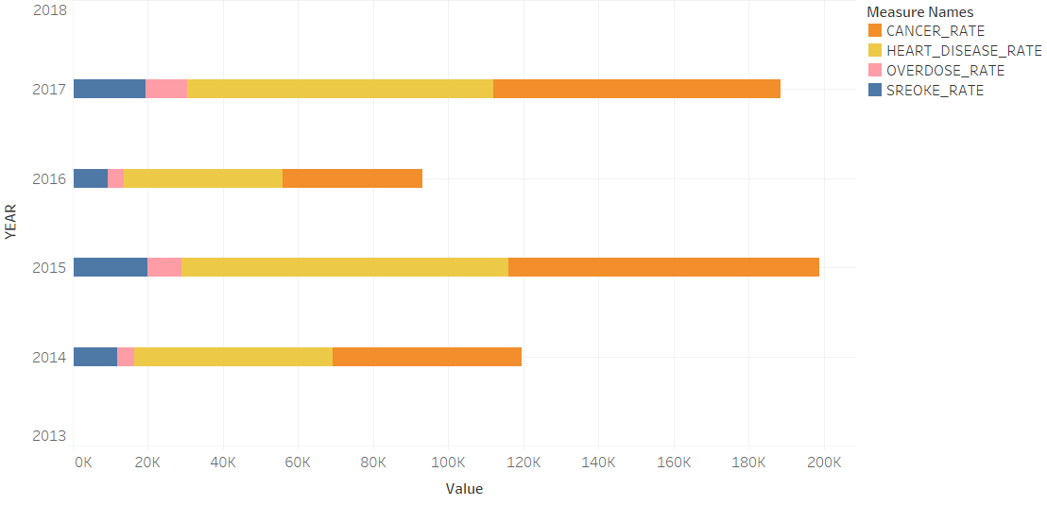
Figure 4. Mortality rates in different diseases - Xin Sui
The figure above is the horizontal stacked bar chart showing the mortality rates in 4 types of disease including cancer, heart disease, overdose and stroke.
In each year from 2014 to 2017, the mortality rate of heart disease remains the highest, followed by that of cancer, stroke and overdose.
It indicates that people are under high risk of dying from heart disease, as well as under huge threat of cancer.

Slide 10
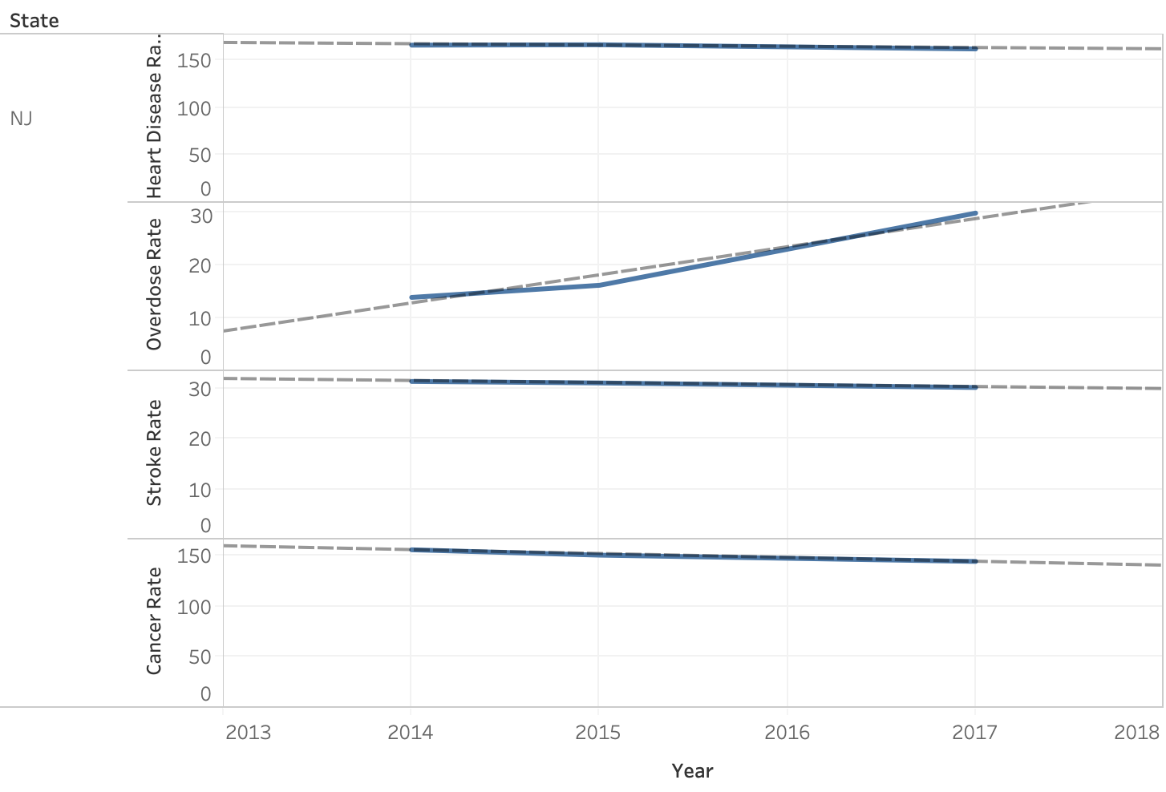
Figure 5. Linear Forecast of Disease Rate in NJ - Bingyue Zeng
Trend lines that predict the death rate of heart disease, cancer, stroke and overdose in state NJ after 2017. R-squared are all above 74%.
Consumption in tobacco has the strongest positive correlation with drug overdose death rate.
Smoking reliability in humans may increase drug addiction, such as opioids use disorder. Restriction on tobacco consumption is needed or more youth will die by drug overdose.

Slide 11
Scope & Limitations
Lack of geographical feature: the research does not cover all the states in the United States.
Lack of latest data: if we could have the latest datasets, which is from 2018 to 2020, released by CDC, we may implement a more structural and systematic longitudinal analysis.
Such as, prediction model with higher R-Squared mortality rates in 4 types of diseases.
Imbalance classes among 3 types of tobacco use. The observations of tobacco use, smokeless tobacco, and tobacco cessation varies.

Slide 12
Conclusions & future research
We derived conclusions in the following aspects:
Higher smoking rate is associated with higher death rate.
The mortality rate sharply decreases in states that implement specific cultural rules or increases in states that population structure varies.
This study found out how different demographic features would affect the smoking rates.
Male smoking rate larger than female , high school smokers’ average smoking rate is larger than middle school smokers
This study found out the magnitude of different mortality rates correlated with the smoking rates: heart diseases and cancer are top high risks.
Beyond the slides, this study built one ANOVA model testing the differences of treatment among different smoking groups. The smoking types are significant. Customizing the policies of tobacco consumption.
This study would open some new ways for researchers to examine more detailed causal effects of youth smoking on mortality.
eg. drill down to education level. High school smokers and middle school smokers vary in percentage of tobacco consumption, differentiate them.

Slide 13
Policy/Managerial implications/recommendations
Bureau of Alcohol, Tobacco, Firearms and Explosives should encourage the non-Tobacco states to introduce related policies.
As insured, the smoked youth should be charged for higher insurance premium, especially in those states with higher smoke rates.
There should have more rewards of cigarette cessations in high school than middle school male students.
The propaganda of the potential diseases especially heart disease and cancer caused by all types of smoking.

